Slide 1


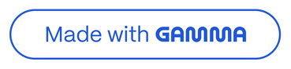
Student Performance Prediction Using Scikit-learn & XGBoost
Predicting final grades from demographic, social and academic factors to enable early intervention and targeted support
Notes:
1

Slide 2

Project Overview
The Challenge
The Data
We aim to predict students' final grades through both regression and classification approaches. By analysing demographic, social and academic inputs, we enable educators to intervene early and provide targeted support where it's needed most.
Our dataset encompasses a comprehensive range of factors including age, gender, parental education levels, study time, attendance records, past grades, family support structures, and extracurricular participation. All data has been thoroughly cleaned with missing values handled and categorical encoding applied.
Notes:
2

Slide 3
Tools & Libraries in Our Arsenal
pandas
numpy
matplotlib
Data loading, cleaning and table manipulation
Numeric operations and efficient array handling
Visualising distributions and relationships
scikit-learn
XGBoost
Preprocessing, model building, evaluation metrics and pipeline orchestration
High-performance gradient boosting for superior regression accuracy
Additional tools include LabelEncoder and pd.get_dummies for categorical conversion, StandardScaler for feature normalisation, and comprehensive metrics including R², MSE, MAE, accuracy and F1 scores.
Notes:
3

Slide 4





Models Implemented
Linear Regression
Random Forest Regressor
XGBoost Regressor
Baseline numeric predictor establishing our performance floor
Ensemble method robust to nonlinearity, providing valuable feature importance insights
Typically achieves highest accuracy on tabular educational data
Support Vector Regression
Logistic Regression
Kernel-based approach for capturing complex nonlinear patterns
Classifies students into performance categories for intervention targeting
Notes:
4

Slide 5




Data Preprocessing Pipeline
Data Cleaning
Encoding
Missing values handled through fillna and dropna operations to ensure data integrity
Categorical variables converted to numeric using LabelEncoder and one-hot encoding
Scaling
Train-Test Split
StandardScaler applied for models sensitive to feature ranges
80/20 division ensuring robust model validation
Pipeline Components
Target Transformation
EDA reveals distributions and correlations
For classification tasks, continuous grades are converted into performance bins such as low, medium and high achievement levels, enabling threshold-based intervention strategies.
Cleaning ensures ML-ready numeric matrices
Multiple algorithms compared for predictive power
Notes:
5

Slide 6

Evaluation Metrics Explained
Regression Metrics
Classification Metrics
R² Score
Accuracy Score
Proportion of variance explained by the model. Higher values indicate better fit, with 1.0 being perfect prediction.
Percentage of correctly classified students into performance categories.
F1 Score
Mean Absolute Error
Harmonic mean of precision and recall, particularly robust for imbalanced class distributions.
Average absolute error in grade points — highly interpretable and easy for educators to understand.
Confusion Matrix
Root Mean Squared Error
Reveals types of classification errors, distinguishing false positives from false negatives.
Penalises larger prediction errors, crucial when significant mistakes could impact student outcomes.
Notes:
6

Slide 7





Model Performance Comparison
Best Performer: XGBoost
Achieved highest R² score with lowest MAE and RMSE values across all regression models tested
Linear Regression
Established baseline performance for comparison against more sophisticated models
Random Forest
Strong performance with valuable feature importance rankings for interpretation
Classification Model
Logistic Regression achieved robust accuracy and F1 scores for performance categorisation
Key Finding: Ensemble methods (Random Forest and XGBoost) consistently outperformed simpler baseline models, with XGBoost demonstrating superior predictive accuracy across all evaluation metrics.
Notes:
7

Slide 8
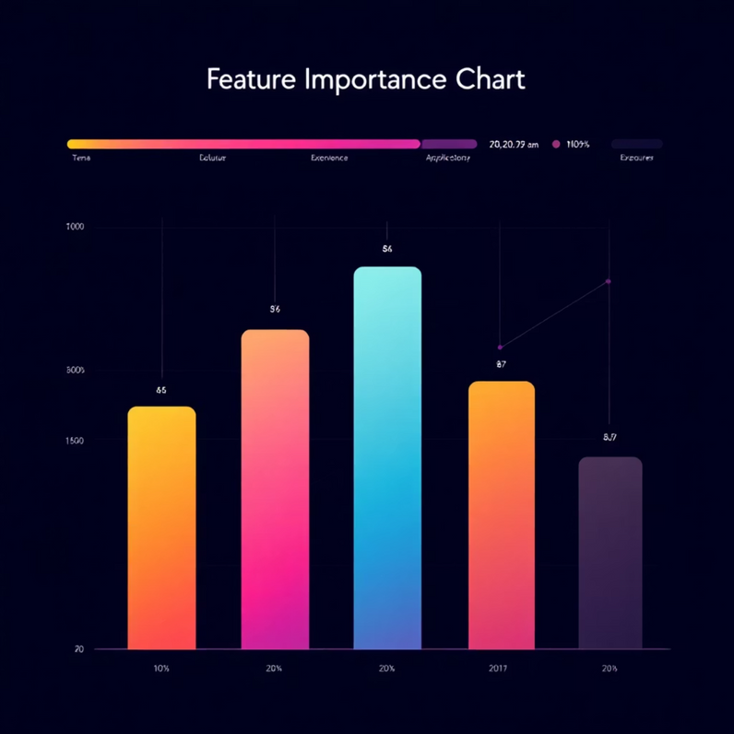
Understanding What Drives Student Performance
Feature Importance Insights
Random Forest and XGBoost models reveal the most influential predictors of student success. Previous grades, study time and attendance emerge as the strongest indicators of final performance.
Actionable Intelligence
Correlation analysis identifies factors educators can influence. Attendance shows particularly strong correlation with final grades, suggesting targeted interventions around engagement and participation could yield significant improvements.
Top Predictive Factors
Interpretability Matters
Previous academic performance, study time allocation, and attendance records
Teachers need to understand why a student is flagged for intervention — feature importance and SHAP values provide clear explanations
Notes:
8

Slide 9





Conclusion & Path Forward
We've built a complete pipeline from raw educational data to deployable predictive models that can identify at-risk students early.
Recommended Next Steps
Enhanced Model Tuning
Implement K-fold cross-validation and systematic hyperparameter optimisation using GridSearchCV or RandomizedSearchCV for more reliable performance estimates.
Explainability Layer
Add SHAP (SHapley Additive exPlanations) for individual student predictions, enabling teachers to understand specific risk factors for each learner.
Interactive Dashboard
Develop a real-time web application allowing educators to view at-risk students, explore predictions and track intervention effectiveness.
Richer Features
Collect additional behavioural data including sleep patterns, study environment quality and digital learning engagement logs to improve predictive accuracy.
Notes:
9

